Slide 1
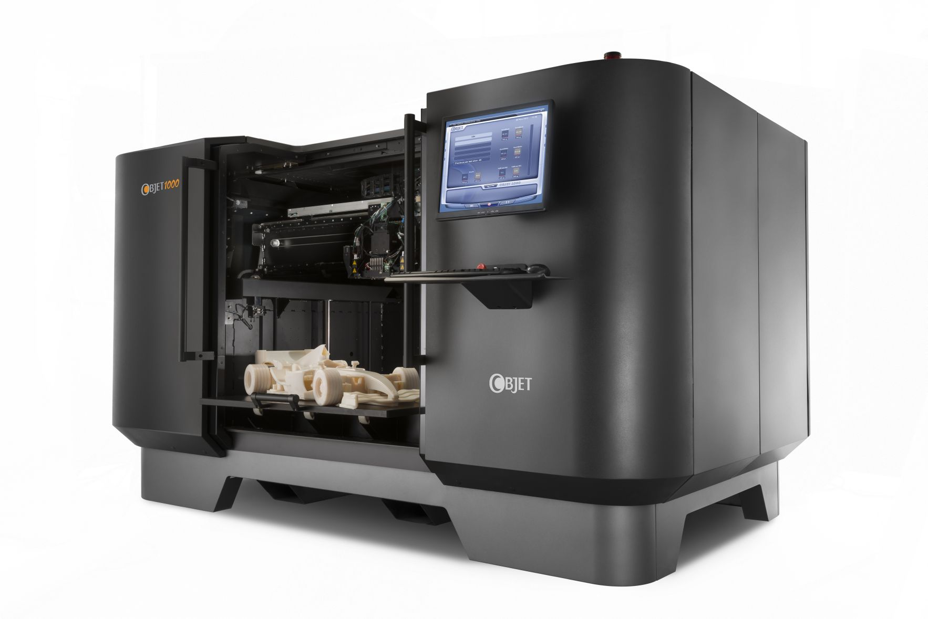
3D Printing
Think about it:
Amazing and revolutionary now (2013).
Everywhere and pretty standard in the future (2023).
So how will it affect our lives in the future?

Slide 2
As you go through this PowerPoint, think about the following:
What is it?
Description, why was it created/history
Types of technology involved (types/models/versions offered)
Capabilities of technology involved (how it works & what is needed to make it work & limitations)
Issues
legal issues
social issues
environmental issues
ethical issues
Stakeholders involved - who and how does it affect:
individuals/users,
organisations
governments,

Slide 3
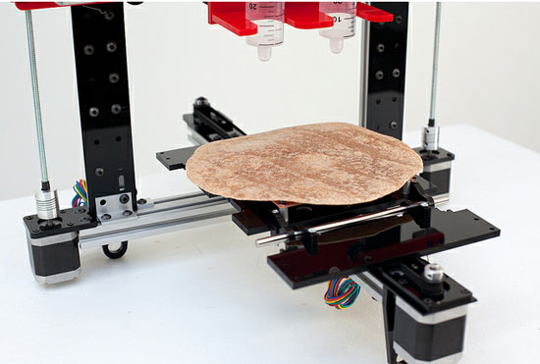
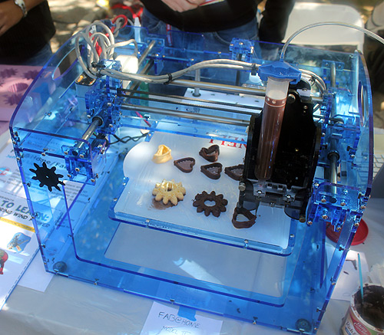
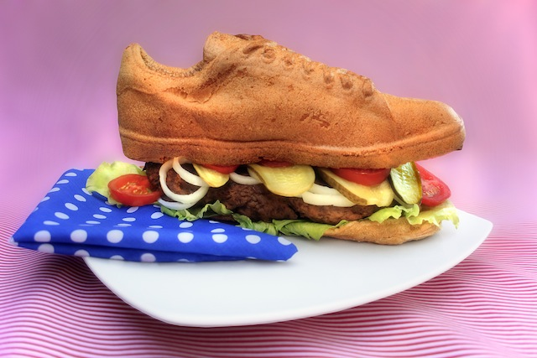
3D printed Food
http://www.youtube.com/watch?v=x6WzyUgbT5A
http://www.slashgear.com/burrito-3d-printer-makes-tastiness-on-the-spot-15234208/
http://www.shapeways.com/blog/archives/977-ready-to-eat-3d-printed-shoe-burger.html
How it may affect stakeholders: http://www.geek.com/articles/geek-pick/a-single-3d-printed-burger-currently-costs-over-300000-to-make-20130122/

Slide 4
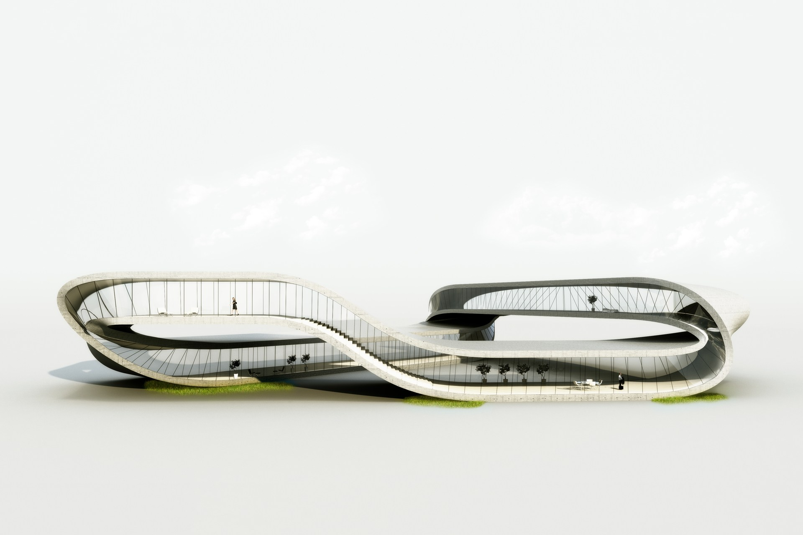
3D printed houses
http://www.wired.co.uk/news/archive/2013-01/24/dutch-architect-3d-printed-house

Slide 5
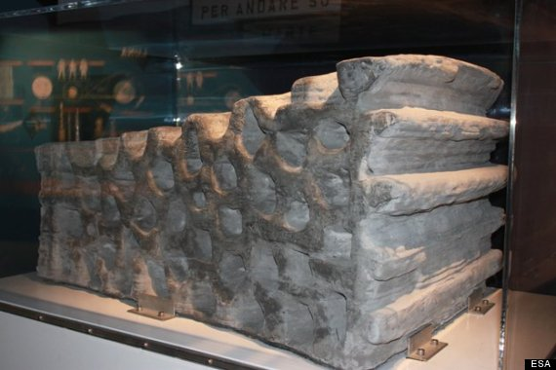
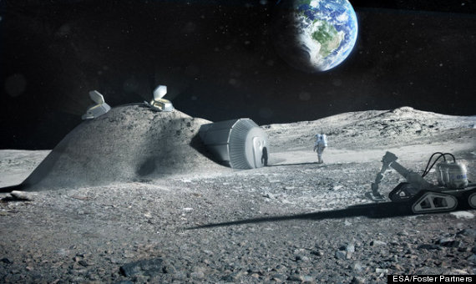
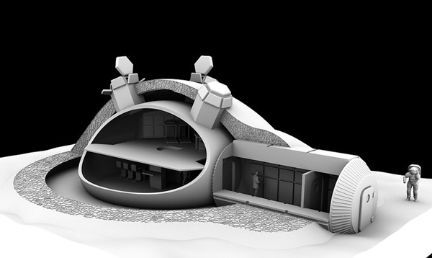
3D printed moon base
http://www.huffingtonpost.com/2013/02/06/ \esa-moon-base-3d-printing-_n_2624567.html

Slide 6
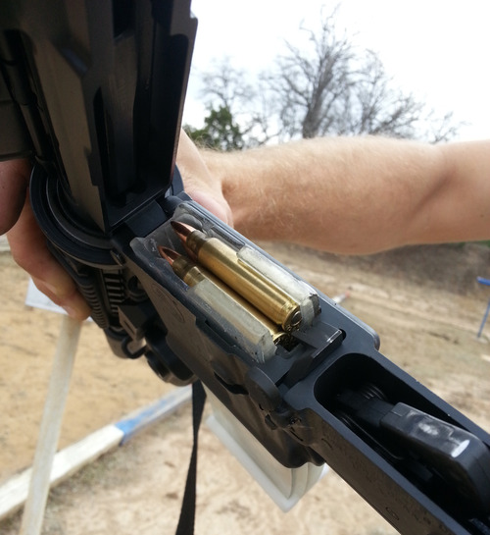
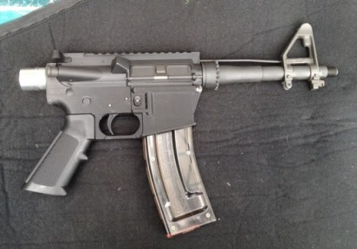
3d printed weapons
http://arstechnica.com/tech-policy/2013/03/download-this-gun-3d-printed-semi-automatic-fires-over-600-rounds/
legal issues: http://www.cio.com.au/article/456941/would_3d-printed_gun_really_legal_/?utm_medium=rss&utm_source=sectionfeed

Slide 7
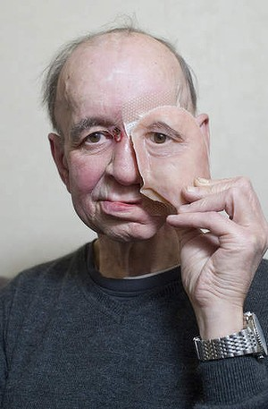
3D printed cosmetic and reconstructive surgery
How a 3D printer gave a man his face - and his life – back
http://www.smh.com.au/technology/sci-tech/how-a-3d-printer-gave-a-man-his-face--and-his-life--back-20130401-2h2a4.html

Slide 8
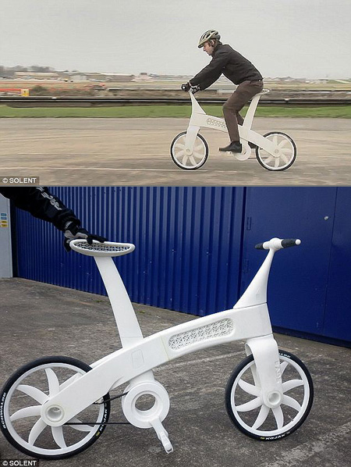
3D printed bike
http://www.gizmodo.com.au/2011/03/ 3d-printed-airbike-is-as-strong-as-your-aluminium -bike/
http://www.youtube.com/watch?v=hmxjLpu2BvY

Slide 9
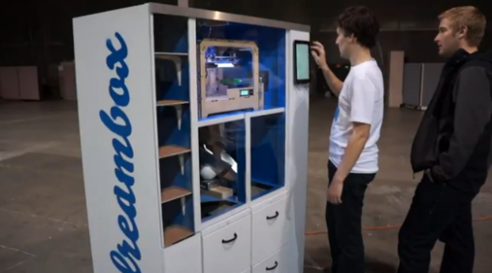
3D printing kiosk
http://dottech.org/100905/dreambox-is-a-3d-printing-vending-machine-lets-you-print-whatever-you-want-using-3d-printer/

